Slide 1
Centralized and Portable, Employee-Maintained Personal Health Record (PHR) To Facilitate Interoperability of Medical Information Among All Parties
HR Specialty Products & Services Catalogue Executive Summary
A No Frills Distillation of Vendor’s Marketing Collateral
Thomas A Ference
President & CEO
Human Resources Mining & Distribution Co
Locating, Validating and Accelerating HR Innovation
Office: 219-662-0201
Cell: 630-240-2583
Fax: 219-661-0236
e-mail: tference@hrmdco.com
Website: www.hrmdco.com

Slide 2
Employee-Maintained , Centralized PHR
Employees and family members may see multiple providers resulting in their having multiple prescriptions, procedures, medical tests, etc.
Such information is typically stored within each provider’s closed date base and provided to plan members piecemeal by each provider such that a consolidated personal / family record is never available.
This 18-months-in-the-development, HIPAA secure and 24 hour-call –center-supported web portal walks employees through entering their own (and their family member as desired) information from multiple provider and other sources so as to maintain a centralized PHR. .

Slide 3
Employee-Maintained , Centralized PHR
Such health information includes but is not limited to clinical histories, allergies, prescriptions unlimited documents, etc.
Stored information can be printed off prior to or viewed on a PDA at time of, a provider visit so as to facilitate the providers’ on-site, laborious and paper-based “fill-out-the -forms “ritual.
Results include elimination / reductions in duplicate testing, unnecessary doctor visits and absenteeism.
The portal also reduces time spent during working hours addressing caregiving responsibilities, tracking down medical records and managing health issues.

Slide 4
What’s included in the PHR
Allergies and adverse drug reactions
Medications (including dosage and how often taken)
Illnesses and Hospitalizations
Surgeries and other procedures
Chronic Diseases
Vaccinations
Test results and imaging reports
Family History
Emergency Contacts
Documents including lab reports, images, advanced directives, etc.

Slide 5
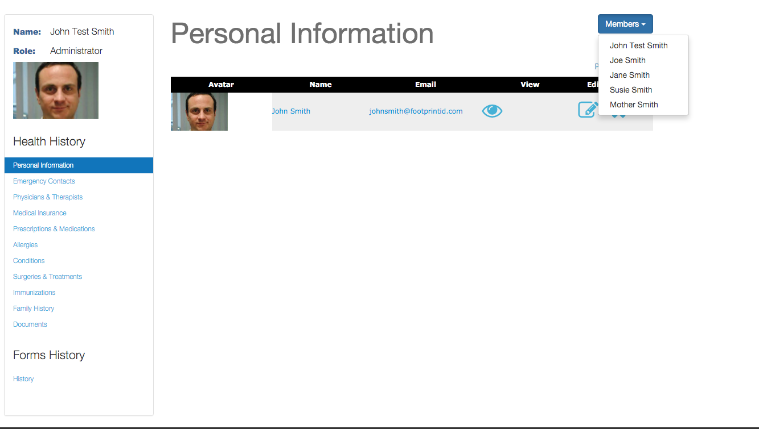
Patient Enters Desired Data

Slide 6
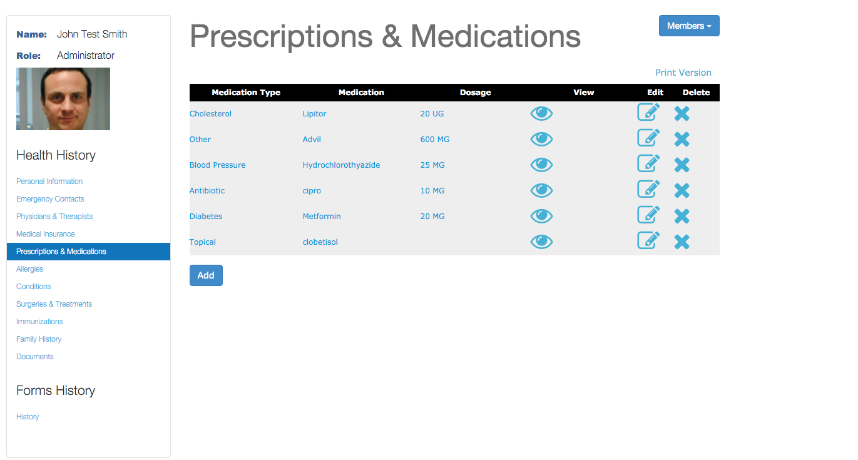
Prescription / Medication Data Example

Slide 7
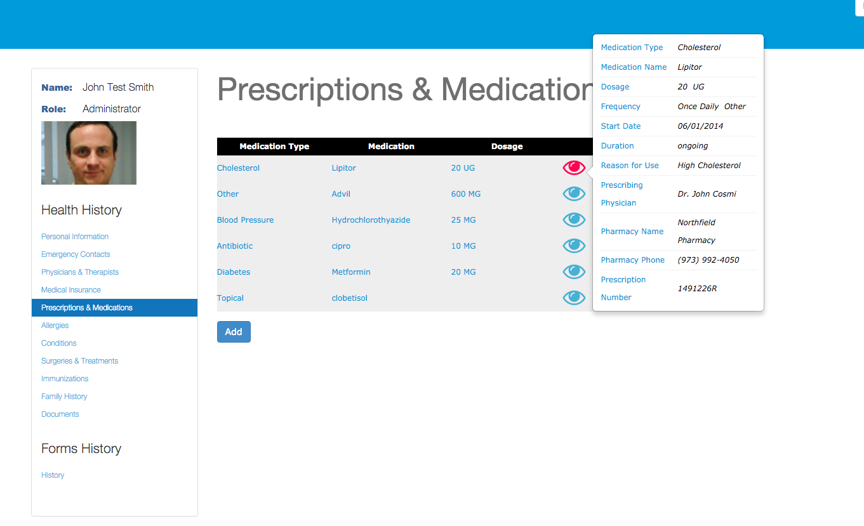
Prescription / Medication Data Example

Slide 8
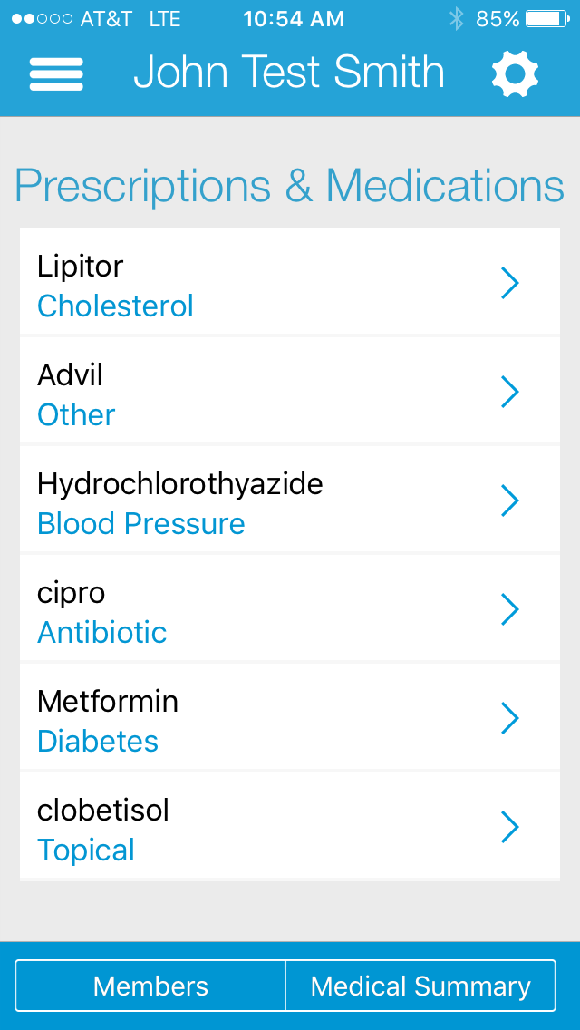
Mobile App - Prescription / Medication Example

Slide 9
Next Steps
This product/service is contained in the HR Specialty Products & Services Catalogue™
Operational level details about this particular service provider can be obtained in conference with the vendor
The HR Mining &Distribution Co. is an independent and contracted representative of the vendor
Upon your request, we will arrange for an introduction that can range from a simple, quick conference call to a services overview / system demo
Tom Ference 219-662-0201 (Chicagoland area) or tference@hrmdco.com
Thank you for your potential interest in this fresh thinking

