Slide 1
Job-Specific, Simulation-Based, Whole-Person Pre-Hire Assessments
HR Specialty Products & Services Catalogue Executive Summary
A No Frills Distillation of Vendor’s Marketing Collateral
Thomas A Ference
President & CEO
Human Resources Mining & Distribution Co
Locating, Validating and Accelerating HR Innovation
Office: 219-662-0201
Cell: 630-240-2583
Fax: 219-661-0236
e-mail: tference@hrmdco.com
Website: www.hrmdco.com

Slide 2
Job-Specific, Simulation-Based, Pre-Hire Assessments
In tight labor markets, companies need to make a positive impression on employment candidates to avoid losing them to the competition.
At the same time, companies need a fast and effective means of identifying candidates who are likely to perform well and remain with the company long enough to return their investment in training.
This assessment uses animated simulation to simulate specific jobs, and covers all key classes of competencies:
-cognitive,
-personality,
-behavioral history, and
-skills/knowledge

Slide 3
Job-Specific, Simulation-Based, Pre-Hire Assessments
The simulations are consistently rated by candidates as engaging and high quality.
Makes all other pre-employment assessments seem outdated.
A library of 200+ off-the-shelf simulation-based assessments is offered, conforming to individual job titles based on O*Net.
Each assessment is a pre-packaged “Whole Person” assessment that measures all critical categories of dimensions in one package.
Additionally, the company produces customized animated or video-based simulations typically for larger clients.
Company is consistently rated highly for responsiveness and quality by employers using the service.

Slide 4
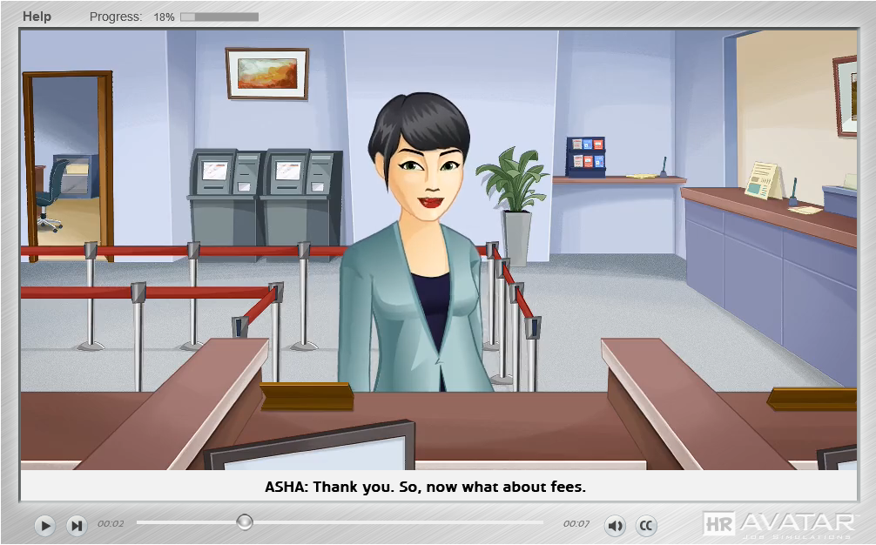
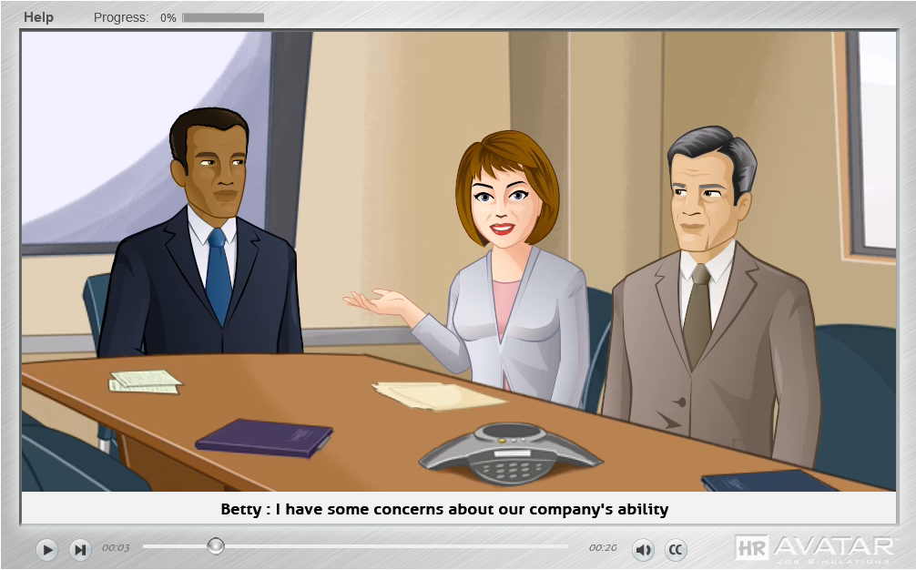
Sample Simulation Screen Shots
Bank Teller
Manager
200+ Different Job titles Available

Slide 5
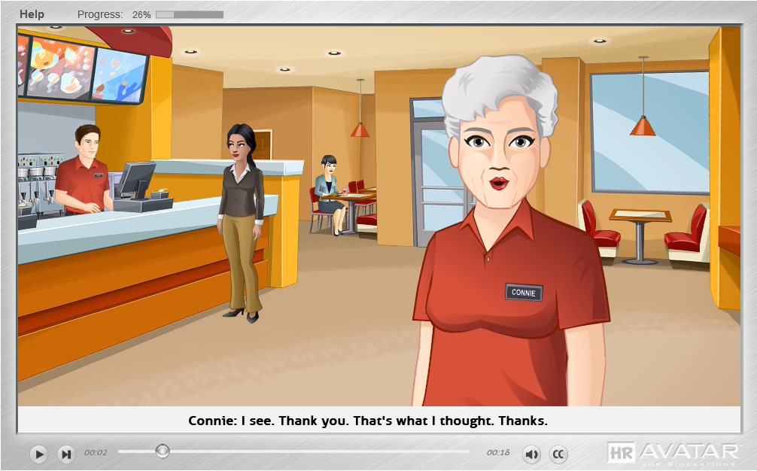
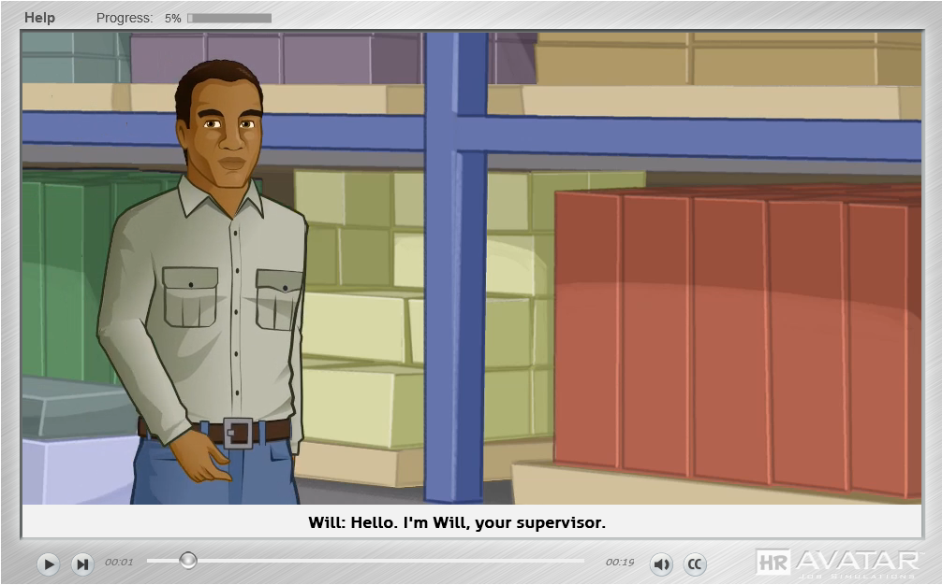
Sample Simulation Screen Shots
Fast Food Service
Warehouse Worker
200+ Different Job titles Available

Slide 6
Candidate Experience Post-Test Survey Results from 2500+ Test Takers
Rated Dimension | Rated Acceptable or Higher
Test Realism | 97%
Ease of Use | 99%
Animation Quality | 99.9%
Overall Test Experience | 99%

Slide 7
Next Steps
This product/service is contained in the HR Specialty Products & Services Catalogue™
Operational level details about this particular service provider can be obtained in conference with the vendor
The HR Mining &Distribution Co. is an independent and contracted representative of the vendor
Upon your request, we will arrange for an introduction that can range from a simple, quick conference call to a services overview / system demo
Tom Ference 219-662-0201 (Chicagoland area) or tference@hrmdco.com
Thank you for your potential interest in this fresh thinking

