Slide 1
Onsite Clinic That Empowers People to Take Control of Their Personal Health
HR Specialty Products & Services Catalogue Executive Summary
A No Frills Distillation of Vendor’s Marketing Collateral
Thomas A Ference
President & CEO
Human Resources Mining & Distribution Co
Locating, Validating and Accelerating HR Innovation
Office: 219-662-0201
Cell: 630-240-2583
Fax: 219-661-0236
e-mail: tference@hrmdco.com
Website: www.hrmdco.com

Slide 2
“Control Your Personal Health” Model, Onsite Clinic
Most onsites “just” deliver the required care and fail to work on improving the health risks embedded in the workforce so as to also decrease long term costs
This onsite model instead is patient participatory so as to create close collaboration between the patient and provider
At every visit, the provider explores the root causes for health issues and conditions taking a holistic care approach
Proprietary health coaching methodology deploys:
-Motivational Interviewing
-Appreciative Inquiry, and
-Mindfulness
techniques to create shared decisions that align with the patient’s values, preferences and goals

Slide 3
“Control Your Personal Health” Model, Onsite Clinic
Clinics provide / can provide the full range of “non-occ” and occupational services tailored to each employer’s needs
Computers, tablets and /or smart phones are used to connect, measure, and share medical information, health content, provider information and tools to stay on track
Robust workforce reporting (see samples below) is provided on overall health, most prevalent heath risks, progress with reducing risk factors, savings associated with changes to risk profiles and healthcare costs of engaged vs non-engaged
Vendor has 12 years of sustained organic growth, 150+ locations across the US and applies Six Sigma and Lean rigor to operations

Slide 4
Control Your Personal Health” Model, Onsite Clinic
Components of vendor’s internal quality assurance program include use of :
- Evidence based clinical guidelines
-Quality Assurance Committee
- Policy & Protocol Committee
- Clinical Peer Support Program
There is a guaranteed pricing structure, $0 markup on labs, drugs, serums, vaccines and a Performance Guarantee equal to 10% of the total fixed annual fee
Service focused culture has produced a 97% ambassador satisfaction, 100% client reference and 98% patient satisfaction

Slide 5
Philosophy in Practice
Population
Health
Identify Risk
Information
Claims Data HRA Biometric Screen Population Stratification
Mitigate Risk
Intervention
Comprehensive Health Review Health Coaching Disease Management
Change Utilization
Impact
Alter Risk Profile Discover/Treat Undiagnosed Conditions Reduce ER/ UC/Specialist & Hospital Stays
Capture Savings
Outcomes
Lower Claims Fewer Lost Work Days Higher Productivity
Patient
Health
Primary Health /Occupational Health/ Onsite Rx
Acute, Primary Care, Health Prevention & Health Risk Management

Slide 6
Sample Report- Encounter Type, Volume and Value

Slide 7
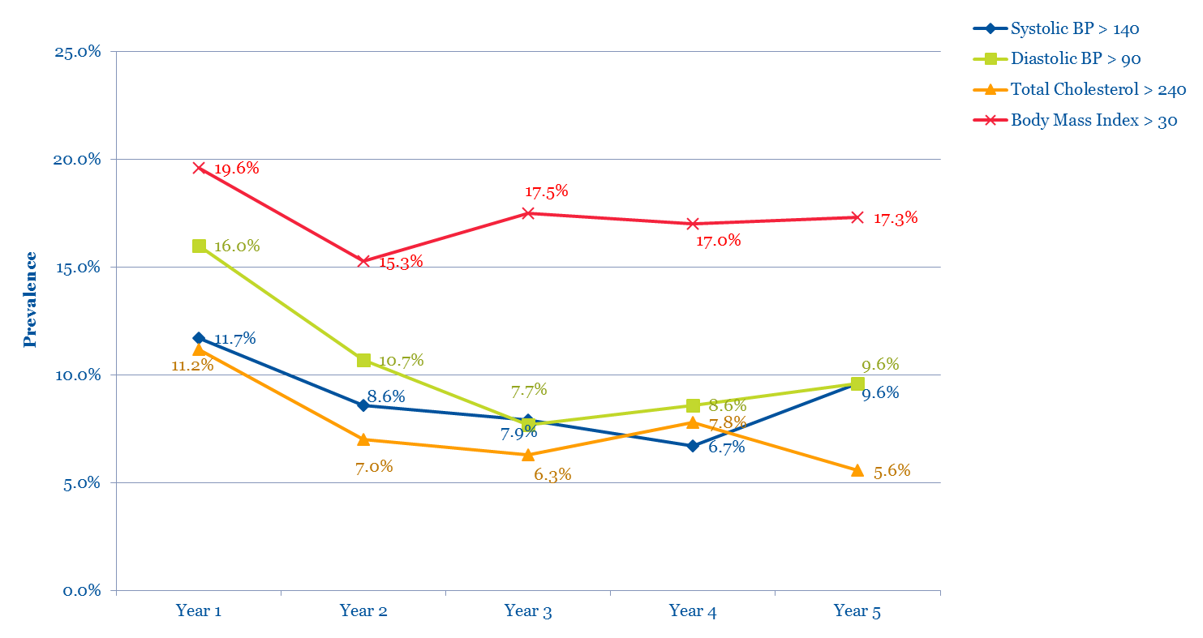
Sample Report - Matched Cohort Analysis

Slide 8
Sample Report - Patient Outcomes vs. Published Goals

Slide 9
Next Steps
This product/service is contained in the HR Specialty Products & Services Catalogue™
Operational level details about this particular service provider can be obtained in conference with the vendor
The HR Mining &Distribution Co. is an independent and contracted representative of the vendor
Upon your request, we will arrange for an introduction that can range from a simple, quick conference call to a services overview / system demo
Tom Ference 219-662-0201 (Chicagoland area) or tference@hrmdco.com
Thank you for your potential interest in this fresh thinking

