Slide 1
Software for Projecting and Analyzing Labor Costs for Collective Bargaining, Workforce Planning, Budgeting or Mergers and Acquisitions
HR Specialty Products & Services Catalogue Executive Summary
A No Frills Distillation of Vendor’s Marketing Collateral
Thomas A Ference
President & CEO
Human Resources Mining & Distribution Co
Locating, Validating and Accelerating HR Innovation
Office: 219-662-0201
Cell: 630-240-2583
Fax: 219-661-0236
e-mail: tference@hrmdco.com
Website: www.hrmdco.com

Slide 2
Labor Cost Analysis and Projection Software
Employers and Labor Organizations calculating and projecting labor costs for collective bargaining, workforce planning, budgeting or mergers and acquisitions most often use error-prone, complicated and frequently disconnected spreadsheet models.
This unique software solution produces enhanced accuracy and insight with greater speed and ease of use than a spreadsheet model can.
The software has been in continuous development for over 20 years, improved with the input of hundreds of experts in all industries.
Users enter current provisions and practices related to compensation plans, work rules, time-off allowances, employee benefit contributions and legislated payments.

Slide 3
Labor Cost Analysis and Projection Software
Users enter as many provisions and proposals to change them as they like. They choose what to enter in whatever level of detail they prefer.
Cost projections include consideration of workforce dynamics such as historical or predicted turnover rates, changes in headcount and employees’ changing lengths of service.
Forecasts are provided for up to 10 years.
Robust reporting capabilities allow instant customization for various constituencies or analyses.
Software license includes tailored training and unlimited telephone and internet support for 12 months.
Software provides better analysis and overall decision-making at all levels of the organization.

Slide 4
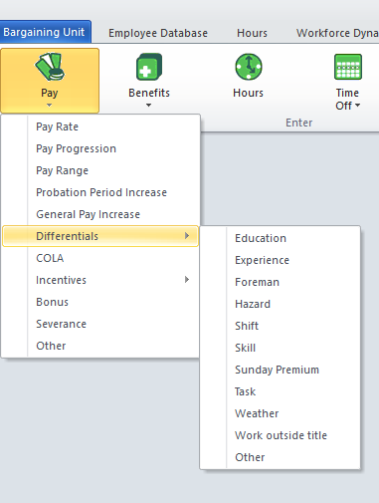
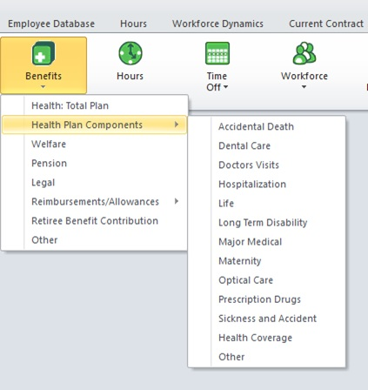
Enter Current Provisions & Proposals

Slide 5
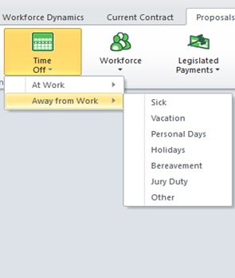
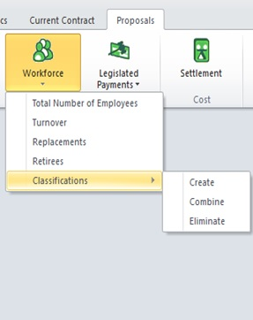

Slide 6
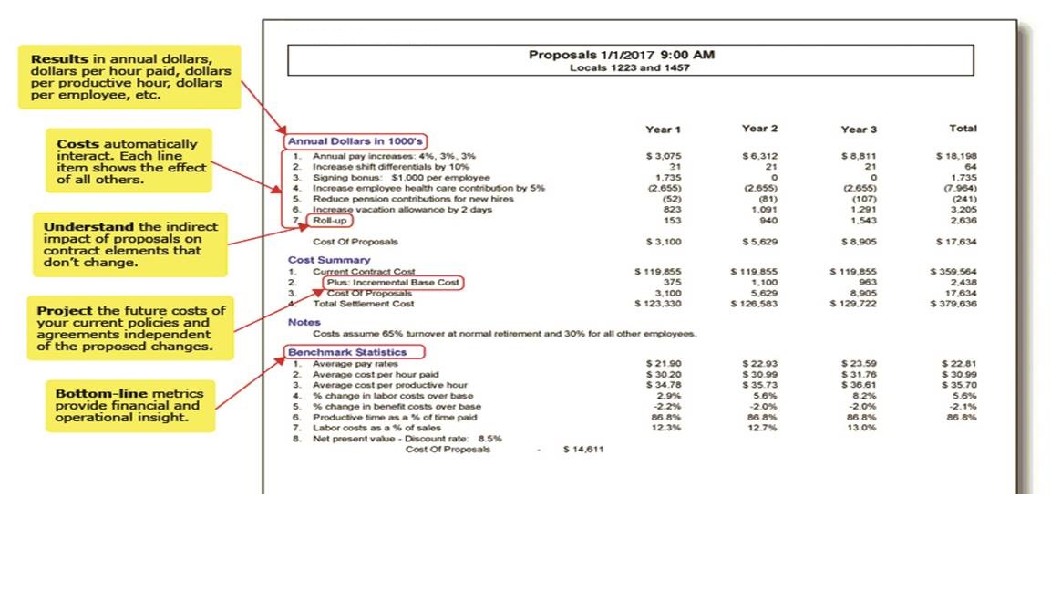
Robust Reporting

Slide 7
Next Steps
This product/service is contained in the HR Specialty Products & Services Catalogue™
Operational level details about this particular service provider can be obtained in conference with the vendor
The HR Mining &Distribution Co. is an independent and contracted representative of the vendor
Upon your request, we will arrange for an introduction that can range from a simple, quick conference call to a services overview / system demo
Tom Ference 219-662-0201 (Chicagoland area) or tference@hrmdco.com
Thank you for your potential interest in this fresh thinking

