Slide 1
“Commitment-Based Management” Tool to Capture Work Agreements and Create Transparent Accountability for Managing All Sizes of Work Projects
HR Specialty Products & Services Catalogue Executive Summary
A No Frills Distillation of Vendor’s Marketing Collateral
Thomas A Ference
President & CEO
Human Resources Mining & Distribution Co
Locating, Validating and Accelerating HR Innovation
Office: 219-662-0201
Cell: 630-240-2583
Fax: 219-661-0236
e-mail: tference@hrmdco.com
Website: www.hrmdco.com

Slide 2
“Commitment-Based Management” Tool for Creating Transparency Around Work Projects
Work assignment execution failures are most often caused by communication breakdowns.
Formal project management tools are appropriate for only large and complex projects.
Current the social media and email tools usually used for work group collaboration lack sufficient structure around the ongoing task-related dialogue to quickly identify who is doing what, where the work stands, and who has the ball.
Instead, this software tool is based on the patented principles of “Commitment Based Management” as developed by social scientists over the last 50 years.

Slide 3
“Commitment-Based Management” Tool for Creating Transparency Around Work Projects
It combines task management with relationship management by recording the two way conversations between the parties starting with the initial request on through work completion while keeping a contextual record of commitments.
It shows who will do what by when, identifies who’s on point for the next action, tracks current status and records the closed-loop deliveries.
The system shows clear agreements between requesters/managers and their assigned performers.
The results are a transparently-managed work product accompanied by a visible audit trail of the ongoing dialogue that can be further analyzed for any anomalies that cause less-than-optimal work processes and having a culture built around accountability and trust.

Slide 4
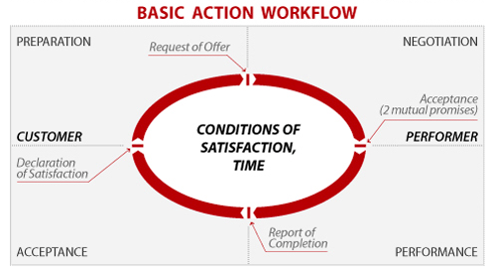
Commitment-Based Management
From “Conversations for Action and Collected Essays” by Dr. Fernando Flores

Slide 5
9-Part Business Execution System
Set up for success
Goals driven
Clear requests
Explicit engagement
Negotiated agreements => Accountability
Follow through
Dialog thread during delivery (workflow shows who’s got the ball)
Real time visibility into progress (performer reports status)
Explicit delivery and assessment (performance improvement)
Feedback to learn from
Scorecards/batting averages/metrics (resource and network analysis)
History archive of completed tasks

Slide 6
Formulating a Task /Commitment Request of Someone

Slide 7
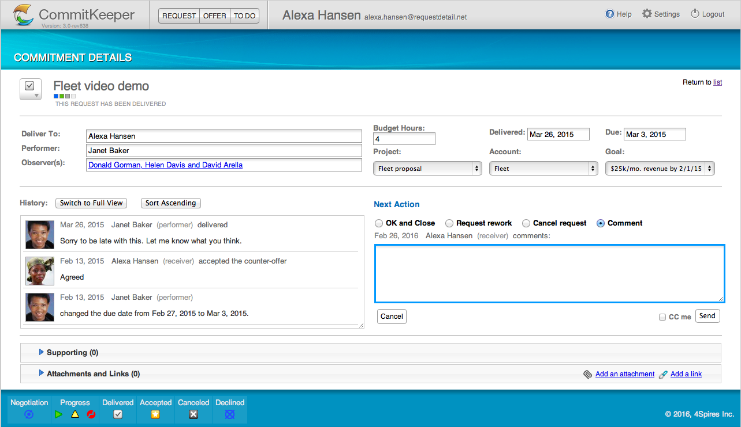
Tracking the Back and Forth Action Dialog

Slide 8
Tracking Commitments- Due From Me, Due From Others, All Active, All Closed

Slide 9
Next Steps
This product/service is contained in the HR Specialty Products & Services Catalogue™.
Operational level details about this particular service provider can be obtained in conference with the vendor.
The HR Mining &Distribution Co. is an independent and contracted representative of the vendor.
Upon your request, we will arrange for an introduction that can range from a simple, quick conference call to a services overview / system demo.
Tom Ference 219-662-0201 (Chicagoland area) or tference@hrmdco.com.
Thank you for your potential interest in this fresh thinking.

