Slide 1
Mobile-to-Employee Site, Hard Data Driven Sleep Management Program
HR Specialty Products & Services Catalogue Executive Summary
A No Frills Distillation of Vendor’s Marketing Collateral
Thomas A Ference
President & CEO
Human Resources Mining & Distribution Co
Locating, Validating and Accelerating HR Innovation
Office: 219-662-0201
Cell: 630-240-2583
Fax: 219-661-0236
e-mail: tference@hrmdco.com
Website: www.hrmdco.com

Slide 2
Mobile-to-Employee Site, Hard-Data-Driven, Sleep Management Program
-Proprietary processes and a technology platform (HIPAA secured, cloud-based), etc. are used to test, diagnose and manage sleep disorders that are often the root cause of hypertension, Type II diabetes, obesity, heart failure, stroke and ADH
-An initial analysis utilizing propriety algorithms can be used as desired to identify specific sleep-disorder-related healthcare costs then develop a directional go-forward strategy
-Post analysis services include sleep testing at employee site (e.g. at truck stop, plant ) , remote sleep monitoring via latest technology, individual and management level reporting on outcomes and progress
-ROI = 1.05 Y1 to 6.3 Y2 and beyond

Slide 3
SLEEP APNEA: THE SILENT KILLER
PREVALENCE OF SLEEP APNEA IN CHRONIC DISEASE
TYPE II DIABETES
72%
HYPERTENSION
37%
STROKE / TIA
70%
OBESITY
72%
CORONARY ARTERY DISEASE
37%
CONGESTIVE HEART FAILURE
70%

Slide 4
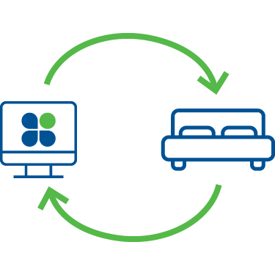
SEAMLESS CARE DELIVERY
FREE TELECLINIC DIAGNOTICS
CONTINUOUS CARE
RISK ID
DIAGNOSE
INITIATE TREATMENTS
TREATMENT
TRACKING
RECOVERY & MAINTENANCE
At Home or Worksite Sleep Health Risk Assessment
At -Site Multi-Level Sleep
Test w/ Medical Informatics
Sleep Coaching w/ Care Plan
Real-Time Tracking
Ongoing Support
Passive Data Flow Continuous Sleep Health

Slide 5
BETTER SLEEP SOLUTION
40%
95%
<
>
engagement
engagement
132
5
STANDARD
SLEEP
PARADIGM
days to receive care
days to receive care
THIS SLEEP MANAGEMENT SOLUTION
WELLBEING
50%
90%
<
>
success rate
success rate

Slide 6
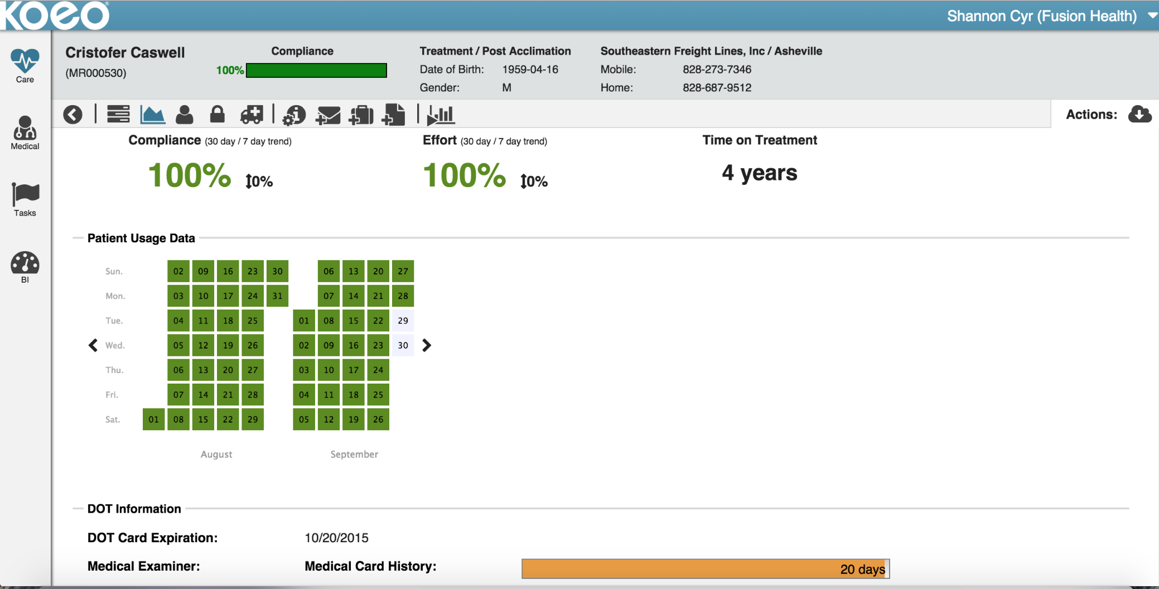
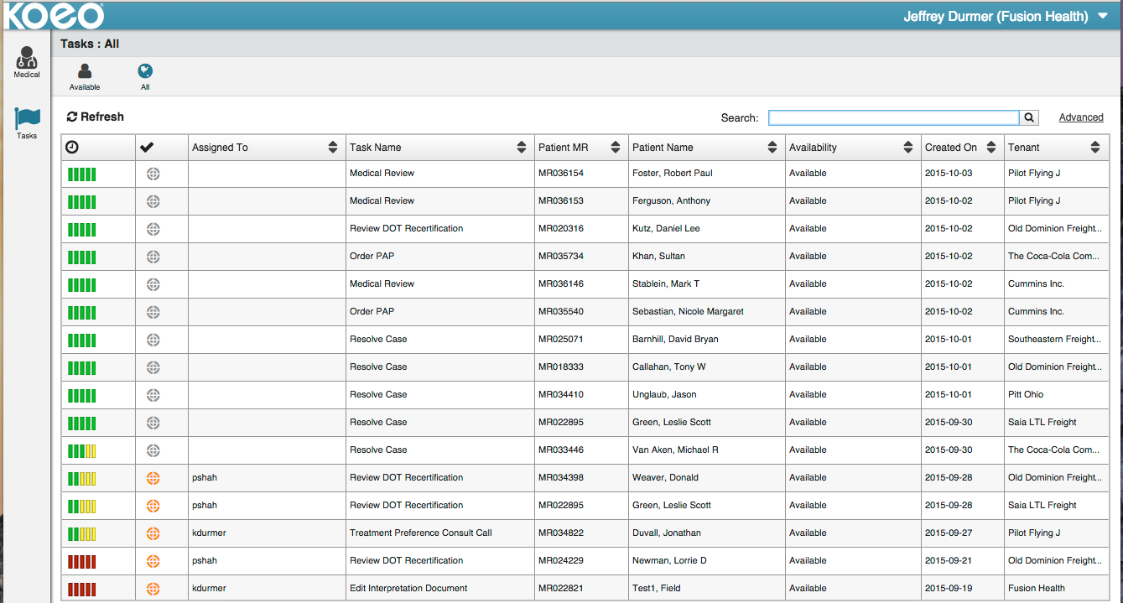
CONTINUOUS CARE CYCLE
INDIVIDUAL MEASUREMENTS
SYSTEMATIC ESCALATION
CONTINUOUS CARE
TREATMENT
TRACKING
RECOVERY & MAINTENANCE
AHI, AI, HI, Central/Complex Apnea
Mask Leaks, Pressures
Effort & Compliance
Successful Use (Weeks, Days, Hrs) Recertification Dates & Requirements
Medical History & Sleep Symptoms
Biometrics & Physical Evaluations
Resupply Schedule by Use Patterns
Personal Motivation Factors Predictive Behavioral Analytics
Behavioral Modification
Technical Barrier Resolution
Treatment Augmentation
Medical Management & Coordination
Therapy Equipment Resupply Certification Data for Medical Examiner
Account Policy Adherence
Account Data Analytics & Reporting
Account Program Enhancements
Real-Time Tracking
& Ongoing Support
Passive Data Flow Continuous Sleep Health
Notes:
RFP Notes:
1.5 - Technical requirements - KOEO allows for transmission of data breath by breath. All that is needed is internet connectivity.
3 - Resources and Support:
Scoping of plan, marketing to associates, rollout meetings, Doctor messaging on sleep health, newsletter, exception reporting, Dedicated Account Management, KPI reporting, business reviews, compliance alerts, direct phone support with a secondary backup, client and participant portal, CME recert THR, physician support via telehealth platform (to participant and CME as needed), RT support via telehealth platform, medical escalation support, sleep coaching support. All done via HIPAA protected and compliant platform.
The patient has a right to protection of PHI, and KOEO stores and owns their medical information.
4 - Service:
Responding to requests - 24/7 coverage via account management. SLA for sleep coaches, respond within 24hrs of request.
Scheduling and coordinating - Scoping thru account management, to work within FedEx associates’ schedules. We build around the participant’s schedule. Example: Right time to call, text, chat. Automatic supply replenishment, notification of delays/issues directly to participant and FedEx, phone numbers to the associate and FedEx to contact for troubleshooting, 2yr. warranty against defects for therapy device.
SLA actuals:
Testing and Treatment - 12-18hrs via teleclinic, 5 days via mail home (provided timely return of sleep testing device)
Education and Training at treatment intitiation - 1hr of training and education + continuous ongoing support
Care Mgt. response time - within 1hr.
Account Management response time - within 24hrs.
Emergencies - directed to call 911 immediately
Hours and days of operation:
office - 8am - 5pm Monday-Friday
Care and Account Management - 24/7

Slide 7
Trucking Company – Actual Case Study
Healthcare Cost Trend Savings
Preventable Accident Reductions
After 12 Months | After 24 Months
22.8% | 22.7%
After 12 months | After 24 Months
69% | 75%

Slide 8
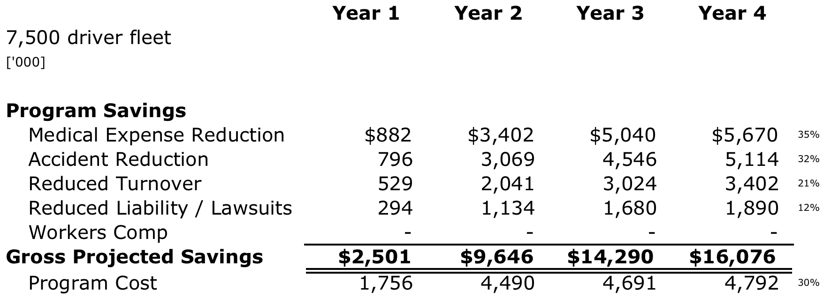
ROI Example Fleet of 7500 Drivers
Stop Loosing 50-100 Basis Points of Profitability

Slide 9
Next Steps
This product/service is contained in the HR Specialty Products & Services Catalogue™
Operational level details about this particular service provider can be obtained in conference with the vendor
The HR Mining &Distribution Co. is an independent and contracted representative of the vendor
Upon your request, we will arrange for an introduction that can range from a simple, quick conference call to a services overview / system demo
Tom Ference 219-662-0201 (Chicagoland area) or tference@hrmdco.com
Thank you for your potential interest in this fresh thinking

