Slide 1
Real Time, Web Based H&B and 401(k) System for Compliance Information and for Execution Responsibility Assignment, Monitoring and Documentation
HR Specialty Products & Services Catalogue Executive Summary
A No Frills Distillation of Vendor’s Marketing Collateral
Thomas A Ference
President & CEO
Human Resources Mining & Distribution Co
Locating, Validating and Accelerating HR Innovation
Office: 219-662-0201
Cell: 630-240-2583
Fax: 219-661-0236
e-mail: tference@hrmdco.com
Website: www.hrmdco.com

Slide 2
Compliance Information and Execution System
ERISA Fiduciaries and Plan Administrators of H&B and K plans are required to assure compliance with the myriad of federal laws and regulations that require forms filing, notice distributions, process adherence and audit, bonding, etc. or else face fines and penalties.
This 8-years-in-the-making-and-refinement compliance tool backed both internal and external legal counsel has been designed to solve the four most common compliance problems.
It assures all required information is at hand, determines what need to be done and when, identifies on-point individuals and documents all activities to help assure task completion and create an auditable compliance trail

Slide 3
Compliance Information and Execution System
Information about each employer and each of the employer’s plans is entered into the system to create an automated compliance road map specific to each employer.
Duties and responsibilities for required tasks are assigned to individuals by the system administrator and monitored via push-type notifications of tasks and due dates supported by dashboard style monitoring of all open, pending and closed activities.
Results include minimization / avoidance of fines and penalties, and pathway to legal defensibility upon audit and peace of mind for those saddled with ERISA responsibilities.

Slide 4
Compliance Quagmire
Plan Admin/Fiduciary Liability
ERISA Title I
Prepare/Distribute Notices
Summary of Benefits and Coverage
Summary Annual Report
Women’s Health and Cancer Rights Act Notice
Children’s Health Insurance Program Notice
HIPAA Preex Condition Exclusion Notice
HIPAA Certificates of Creditable Coverage
HIPAA Notice of Privacy Practices
HIPAA Preex Condition Exclusion Notice
HIPAA Special Enrollment Notice
Medicare Part D Creditable Coverage Notice
Notice of the Health Benefit Exchange
Patient Protections Disclosure
USERRA Rights Notice Reporting & Disclosure
Prepare Disclosure Language/Materials
Qualified Medical Child Support Orders
Newborns’ Protection Act
HIPAA Nondiscrimination
Grandfathered Plan Status
Research and Education
Working Families Tax Relief Act
FMLA Continuation of Coverage
On-Site Clinic ERISA Compliance
ERISA Safe Harbor Delivery Methods
Employee and Dependent Eligibility Requirements
Nondiscrimination Rules (beyond HIPAA)
Maintaining Grandfathered Plan Status Disclosure
COBRA
Administration and monitoring
Participant tracking
Eligibility compliance
Send/document notices
HIPAA Privacy & Security
Implement/Review policies and procedures
Risk assessment/breach notification procedures
Implement/Review administrative, technical and physical safeguards
Audit plan documentation
Workforce training
Bonding Requirements
Every person who handles plan assets
Audit Plan Provisions
Recordkeeping Requirements
Mental Health Parity Act
Subrogation
Claim Procedures
Prohibition of preexisting condition exclusions for enrollee’s under 19
Prohibition of annual and lifetime dollar limits
Prepare Disclosure Language & Materials
Qualified Medical Child Support Orders
Newborns’ and Mothers’ Health Protection Act
HIPAA Nondiscrimination
Grandfathered Plan Status
Prepare Forms/Report to Government
Form 5500
Creditable Coverage to CMS
W-2 Reporting
Prepare/Distribute Plan Documents
Plan
Summary Plan Description
Summary of Material Modifications
Cafeteria Plan

Slide 5
Sample Penalties
Failure to furnish documents (e.g. SPDs, SMMs) = $110 per day, per occurrence after the 30th day of request
Failure to timely file a form 5500 = $1,100 per failure, per day
Violation of HIPAA = $100 per participant, per day during noncompliance (Form 8928)
HIPAA privacy / security violation = $100 - $50,000+ per violation
COBRA Failure = $110 per beneficiary, per day
ACA’ s Summary of Benefits and Coverage (SBC ) failure = $1,000 per failure, per participant
ACA’s market reforms for health care reform failure = $100 per participant, per day
PCORI Fee Failures = 100% of unpaid tax

Slide 6
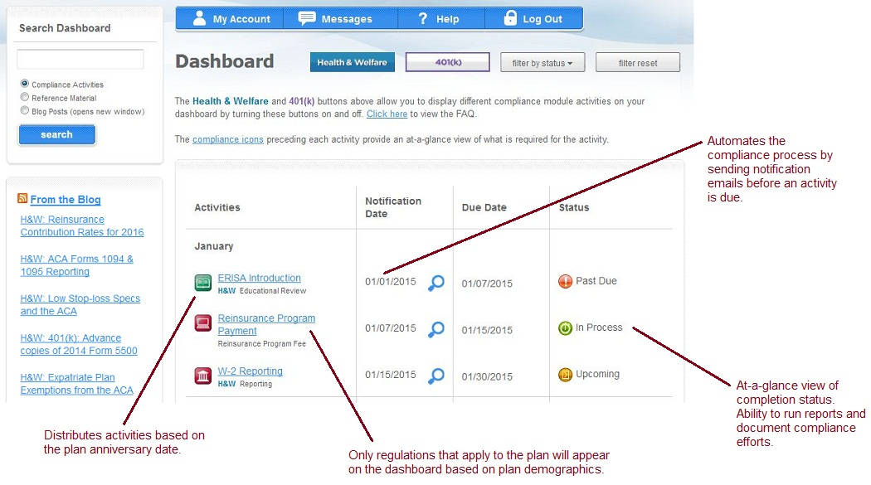
Compliance Solution

Slide 7
Next Steps
This product/service is contained in the HR Specialty Products & Services Catalogue™
Operational level details about this particular service provider can be obtained in conference with the vendor
The HR Mining &Distribution Co. is an independent and contracted representative of the vendor
Upon your request, we will arrange for an introduction that can range from a simple, quick conference call to a services overview / system demo
Tom Ference 219-662-0201 (Chicagoland area) or tference@hrmdco.com
Thank you for your potential interest in this fresh thinking

