Slide 1
Specialized Psychometric Test for Sales Professionals that Measures Personality Traits against Sales Professional Norms
HR Specialty Products & Services Catalogue Executive Summary
A No Frills Distillation of Vendor’s Marketing Collateral
Thomas A Ference
President & CEO
Human Resources Mining & Distribution Co
Locating, Validating and Accelerating HR Innovation
Office: 219-662-0201
Cell: 630-240-2583
Fax: 219-661-0236
e-mail: tference@hrmdco.com
Website: www.hrmdco.com

Slide 2
Specialized Psychometric Test for Sales Professionals
Effectively recruiting new sales professionals or developing existing ones requires:
- assessing the inane aspects of a personality,
- discovering the motivational aspects of the individual and
- understanding his/her attitudes / values
This scientifically validated 6th generation test evaluates 11 dimensions of personality to describe the person’s profile.
Assesses one’s abilities to recognize the level of customer interest, ask questions to identify customer’s needs, use varying strategies to close a sale and influence the client through personal enthusiasm.
Results are compared either to the vendor’s generic norm a corporate norm that vendor helps to the employer to develop
Assessing specific-position-related characteristics against norms allows the employer to identify developmental needs and capitalize on the individual’s existing strengths.

Slide 3
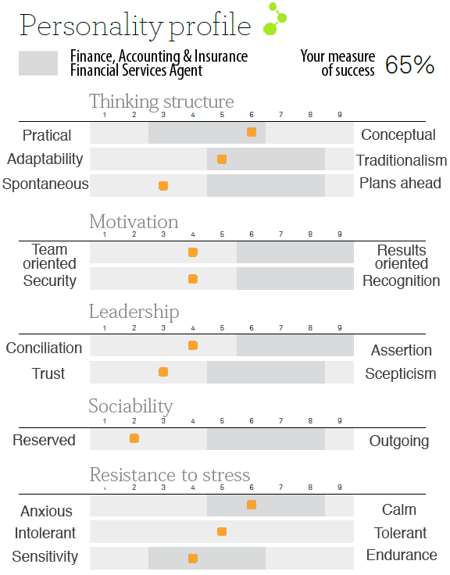
Base Profile of Personality Dimensions vs. Norms
Evaluates natural reflexes
-11 dimensions
-5 sections
Bipolarity of dimensions
-Degree between 2 character traits
(natural reflexes/automatisms)
-Grey area = sought after normative
results
-No bad profiles
-Right person in the right position
Measure of success a percentage representing the fit between a profile and the norm
Able to instantaneously see where an individual will need to improve in accordance with a job position

Slide 4
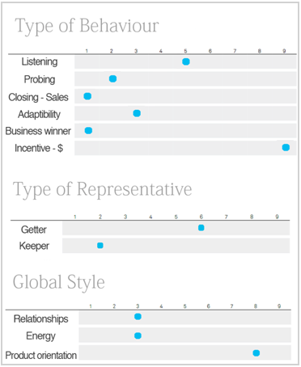
Personality Profile Applied to Sales
Presents the dominant competencies for sales and areas of developmental need by:
Type of behaviour
Type of representative
Global style
Highlight specific competencies along 11 sales related dimensions
Identifies
-Employee restructuring needs
-Where an individual is at his
/ her best
-Sales professional’s capacity
to close a sale, etc…

Slide 5
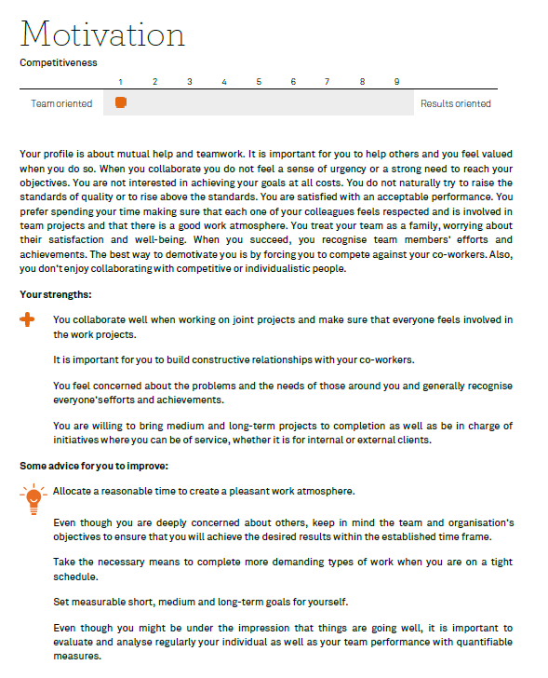
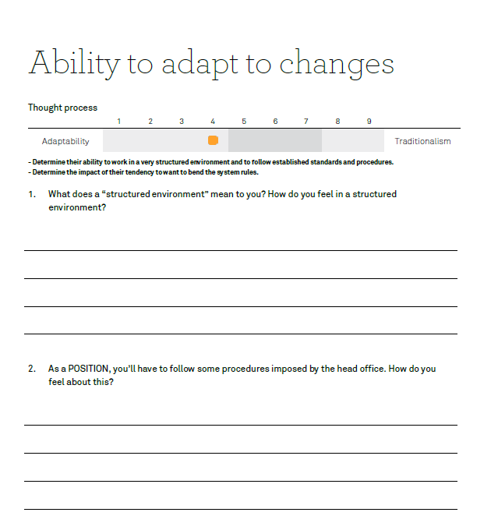
Automatic Report and Interview Guide Generation
Reports highlight strengths and areas for improvement
Interview guides tailored to positon and test responses

Slide 6
Next Steps
This product/service is contained in the HR Specialty Products & Services Catalogue™
Operational level details about this particular service provider can be obtained in conference with the vendor
The HR Mining &Distribution Co. is an independent and contracted representative of the vendor
Upon your request, we will arrange for an introduction that can range from a simple, quick conference call to a services overview / system demo
Tom Ference 219-662-0201 (Chicagoland area) or tference@hrmdco.com
Thank you for your potential interest in this fresh thinking

