Slide 1
Employer Controlled, Business Purposed , Social Networking Reward and Recognition Intranet
HR Specialty Products & Services Catalogue Executive Summary
A No Frills Distillation of Vendor’s Marketing Collateral
Thomas A Ference
President & CEO
Human Resources Mining & Distribution Co
Locating, Validating and Accelerating HR Innovation
Office: 219-662-0201
Cell: 630-240-2583
Fax: 219-661-0236
e-mail: tference@hrmdco.com
Website: www.hrmdco.com

Slide 2
Employer Controlled, Business Purposed, Social Networking Reward and Recognition Intranet
Traditional reward and recognition programs only touch 10% of the employees leaving the remaining group unaffected and untouched
This fully-secured, employer controlled, business intranet is configured as Social Network w/ 5X usage rate of employer’s own intranet
Drives innovation via real time collaboration and knowledge pool exchange within formal open or closed discussion groups established and customizable at the BU level and controlled via multi-level approval feature
Allows managers and employees to e-recognize and e-reward one another for desired values, behaviors and business purposes
e-recognition can be posted on employee and /or company wall
Employer-managed e-rewards portfolio of electronic images can be assigned points which can be monetized and monitored via budget tracking tool

Slide 3
Employer Controlled, Business Purposed, Social Networking Reward and Recognition Intranet
Employees’ “e-wallet” redeemable within an on-line shopping mall
Built-in e-survey tool with ability to create rewards programs around key survey results and issues
R&R’s replete with employers’ company logo, can be shared by employees with external Social Networks like Facebook and Twitter to help create a Recruitment Brand. These external links can be redirected back to employer’s own Career Page to help support the Brand
Traditional Social Networking to find friends, follow people share hobbies /interests, etc. is included as is a Smart Phone app
Robust Business Intelligence tools measure effects of system engagement on revenues, profits, turnover, productivity, etc.
Can be integrated with the employer’s existing intranet
See sample screen shots below

Slide 4
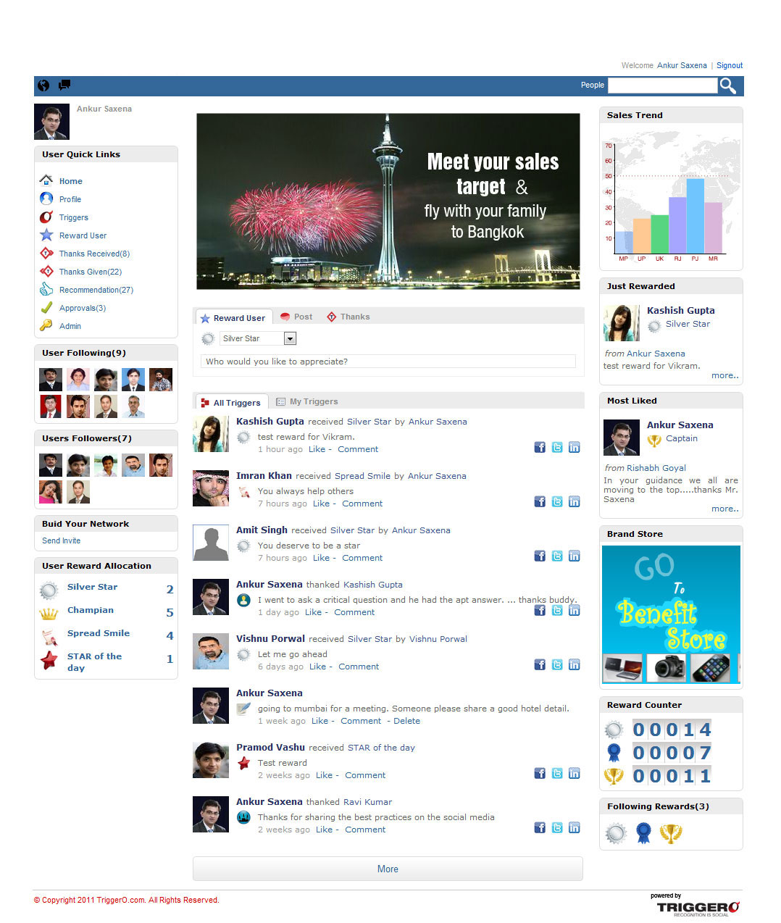
Home Page

Slide 5
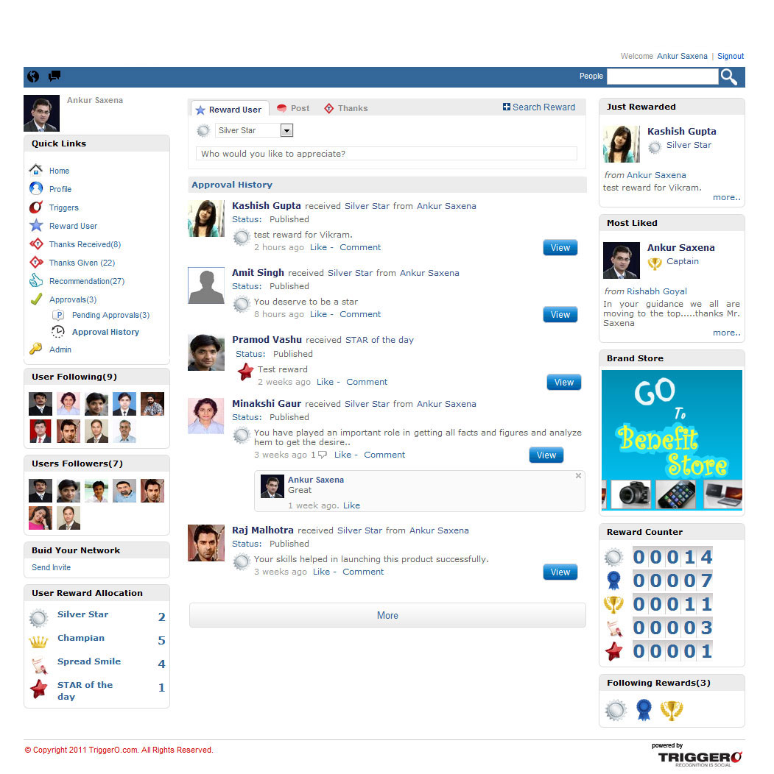
Approval History

Slide 6
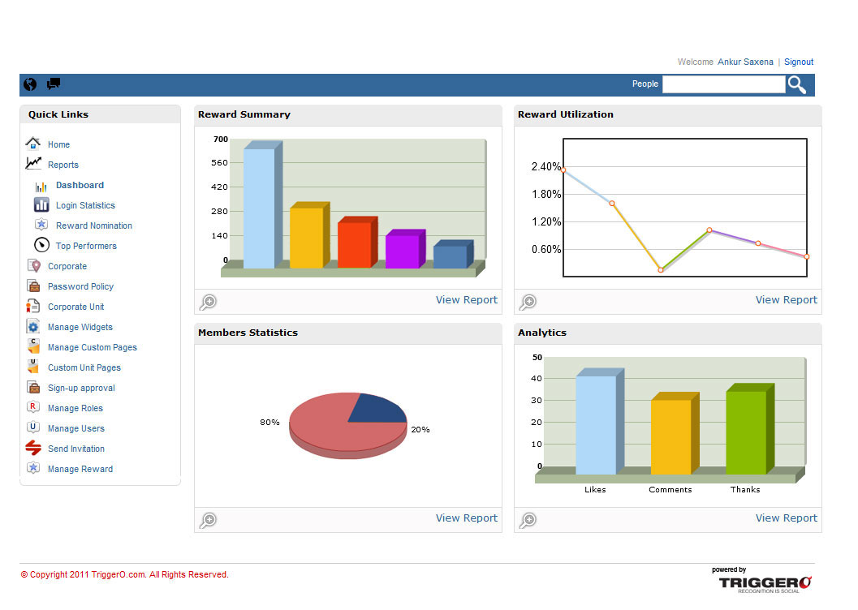
Dashboard
Robust Dashboards

Slide 7
Next Steps
This product/service is contained in the HR Specialty Products & Services Catalogue™
Operational level details about this particular service provider can be obtained in conference with the vendor
The HR Mining &Distribution Co. is an independent and contracted representative of the vendor
Upon your request, we will arrange for an introduction that can range from a simple, quick conference call to a services overview / system demo
Tom Ference 219-662-0201 (Chicagoland area) or tference@hrmdco.com
Thank you for your potential interest in this fresh thinking

