Slide 1
SaaS-Based System to Design, Track and Manage the Types of Employee Wellness Challenges that Require Measurable Results
HR Innovations Catalogue Executive Summary
A No Frills Distillation of Vendor’s Marketing Collateral
Thomas A Ference
President & CEO
Human Resources Mining & Distribution Co
Locating, Validating and Accelerating HR Innovation
Office: 219-662-0201
Cell: 630-240-2583
Fax: 219-661-0236
e-mail: tference@hrmdco.com
Website: www.hrmdco.com

Slide 2
System Highlights
Wellness-oriented employers may want to run various fitness challenges but have neither a tool to help guide them in the design nor a method for tracking and reporting
This system allows the challenge program administrator to establish quantifiable parameters for various types of challenges like walking/physical activity, smoking cessation, weight loss, healthy eating, etc.
Goals, terms, limits/ milestones, reward points, etc. can be set using system-guided drop downs based on data from other administrators’ proven challenges
Participant results can be manually or electronically entered and tracked by the participant or administrator
Management reports track either per participant or employee team.
Excel data files can be easily exported to other systems that require wellness program results

Slide 3
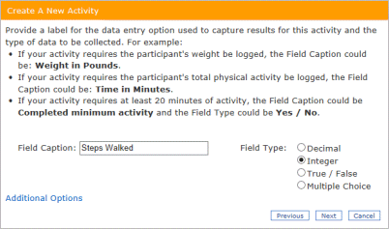
Challenge Designer
Challenges can:
Come from a pre-populated library or be designed from scratch
Include only a single activity or multiple activities
Be run individually or in teams and tracked accordingly

Slide 4
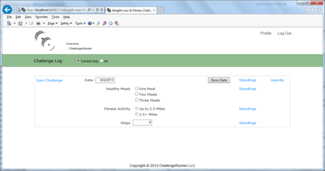
Employee Data Entry
Participant data:
Can be entered online, from smartphone apps, or via automatic upload from a wireless fitness device
Is fully HIPAA compliant and HITECH secure
Is “smart data” verified against norms to prevent “fat-fingered” entries from ruining challenges

Slide 5
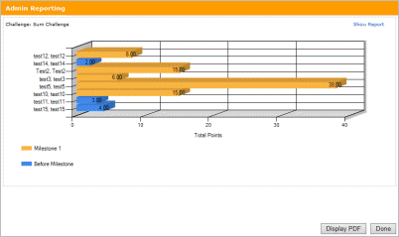
Real-time Leaderboard
Leaderboard :
Is updated continuously and available to all participants and administrators
Tracks against other individuals, teams or individually versus goals
Highlights participant progress vs. any administrator-set milestones
Tracks any challenge awards against milestone attainment for selection by participants.

Slide 6
Next Steps
This product/service is contained in the HR Specialty Products & Services Catalogue™
Operational level details about this particular service provider can be obtained in conference with the vendor
The HR Mining &Distribution Co. is an independent and contracted representative of the vendor
Upon your request, we will arrange for an introduction that can range from a simple, quick conference call to a services overview / system demo
Tom Ference 219-662-0201 (Chicagoland area) or tference@hrmdco.com
Thank you for your potential interest in this fresh thinking

