Slide 1
Cognitive Aggression Reporting and Management System
HR Innovations Catalogue Executive Summary
A No Frills Distillation of Vendor’s Marketing Collateral
Thomas A Ference
President & CEO
Human Resources Mining & Distribution Co
Locating, Validating and Accelerating HR Innovation
Office: 219-662-0201
Cell: 630-240-2583
Fax: 219-661-0236
e-mail: tference@hrmdco.com
Website: www.hrmdco.com

Slide 2
Cognitive Aggression Reporting and Management System
“Primal Aggression”-fueled by adrenalin and loss of control (e.g. fist fights, road rage, etc.) is almost always confused with “Cognitive Aggression”-fueled by hostile/malicious intent (e.g. suicide bombers, rapists, shooters, etc.)
Vendor was first to recognize, literally defined and now owns the entire professional area of “Cognitive Aggression”
Providing education and training courses 15+ years
Has developed proprietary processes and systems to actually prevent employee, student, patient, military, etc. aggressive behaviors such as violence, sexual harassment, racial tension
Actual and legally-defensible prevention as opposed to more traditional post-incident responses-when it is already too late
Only known system in existence that works to intervene and thereby prevent Cognitive Aggression based on hard data

Slide 3
How it Works
The system is built around 8 research defined Indicators of Cognitive Aggression are being exhibited each of which can be exhibited in varying levels or degrees.
Each member of a duly defined and trained team of the employer’s First Observers enters data on potentially aggressive individuals about the varying levels or degrees to which each and any of the 8 Indicators of Cognitive Aggression are being exhibited.
When the dashboard’s Meter of Emerging Aggression™ reaches a certain level, the employer’s Behavioral Intervention Team intervenes with the aggressor to thwart off the aggression from happening in the first place.
The system’s hard data, the management reports and the supporting organizational processes create a pathway to legal defensibility

Slide 4
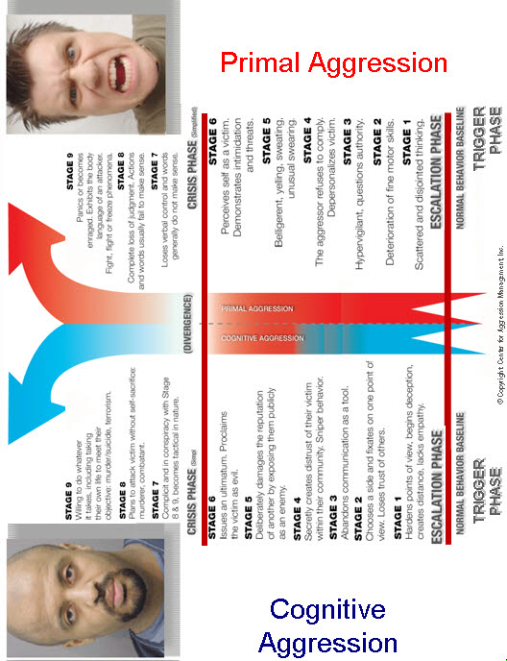
Cognitive VS. Primal Aggression

Slide 5
Meter of Emerging Aggression

Slide 6
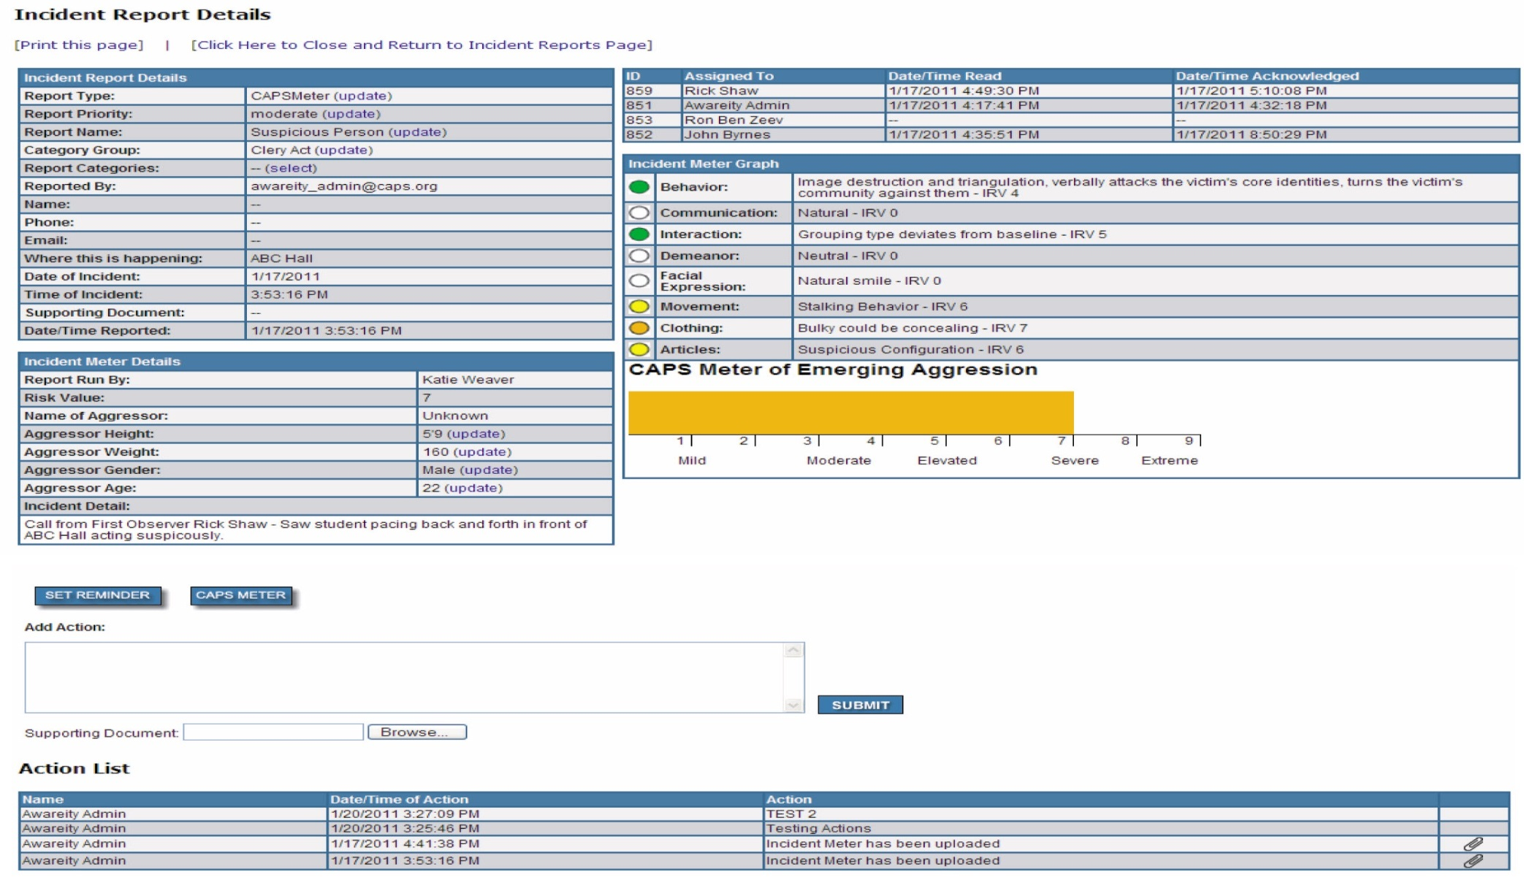
Robust Management Reporting

Slide 7
Next Steps
This product/service is contained in the HR Specialty Products & Services Catalogue™
Operational level details about this particular service provider can be obtained in conference with the vendor
The HR Mining &Distribution Co. is an independent and contracted representative of the vendor
Upon your request, we will arrange for an introduction that can range from a simple, quick conference call to a services overview / system demo
Tom Ference 219-662-0201 (Chicagoland area) or tference@hrmdco.com
Thank you for your potential interest in this fresh thinking

